Slide 1

Speech Emotion Recognition
Daniel Dimond
Data Science Capstone Project 2
Springboard
Special thanks to Abhishek Murthy, PhD

Slide 2
Human Emotion and Machines
The interaction between humans and machines is becoming more and more common.
How we communicate with machines is changing rapidly.
Expanding our tools in one particular way is machine learning emotion detection in human speech.
Why does this matter?
This could be useful for call centers wishing to improve customer service.
Devices that use speech to communicate such as Alexa or Siri.

Slide 3



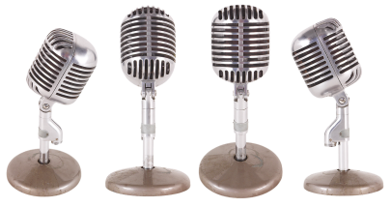
Problem Statement
The purpose of this data science project is to come up with a predictive model for emotion recognition in speech.

Slide 4
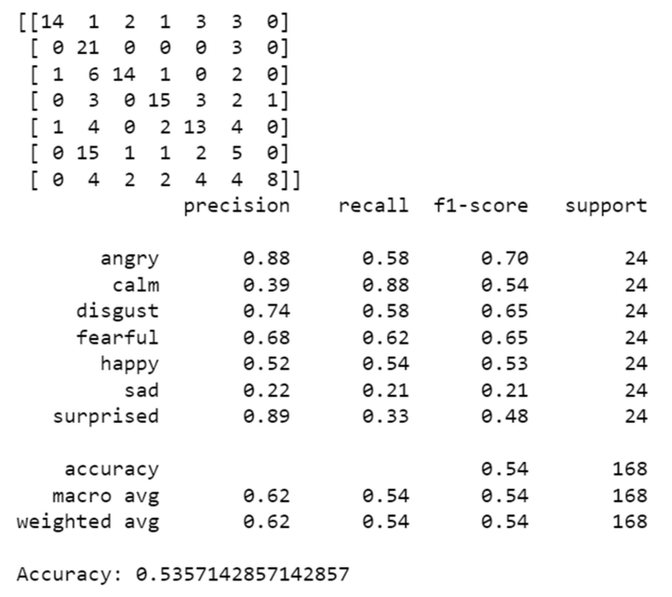
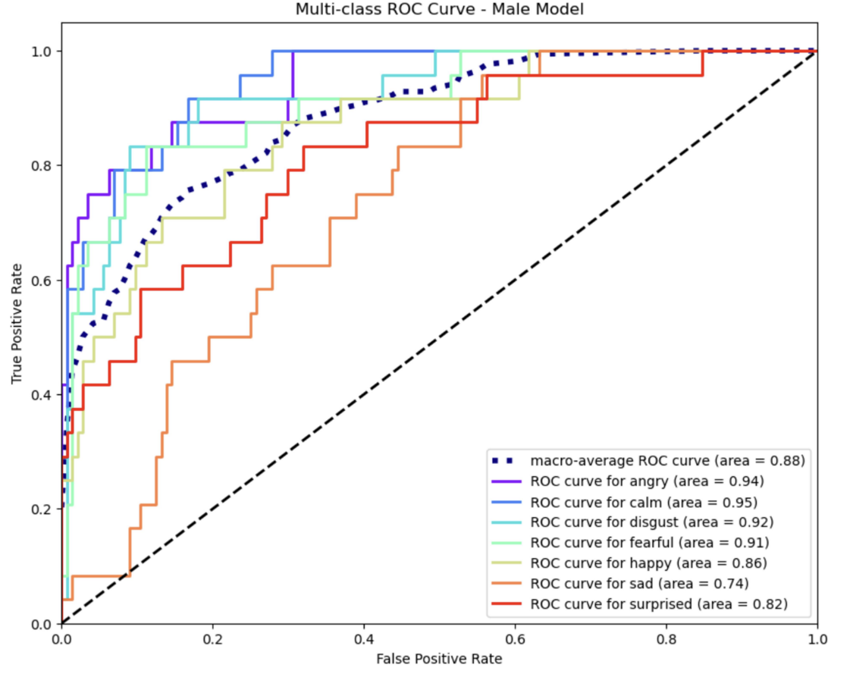
Multi-layer Perceptron Classifier
Male dataset results

Slide 5
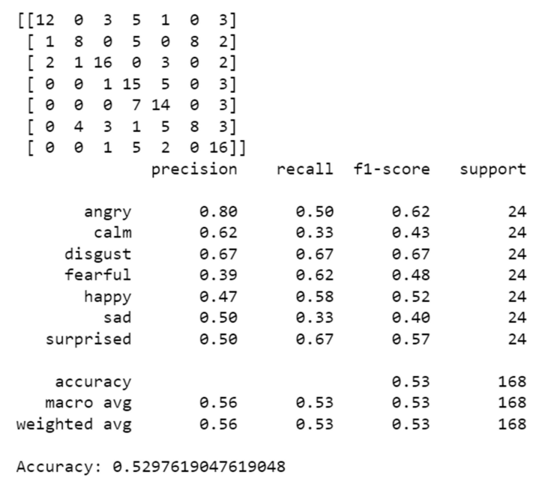
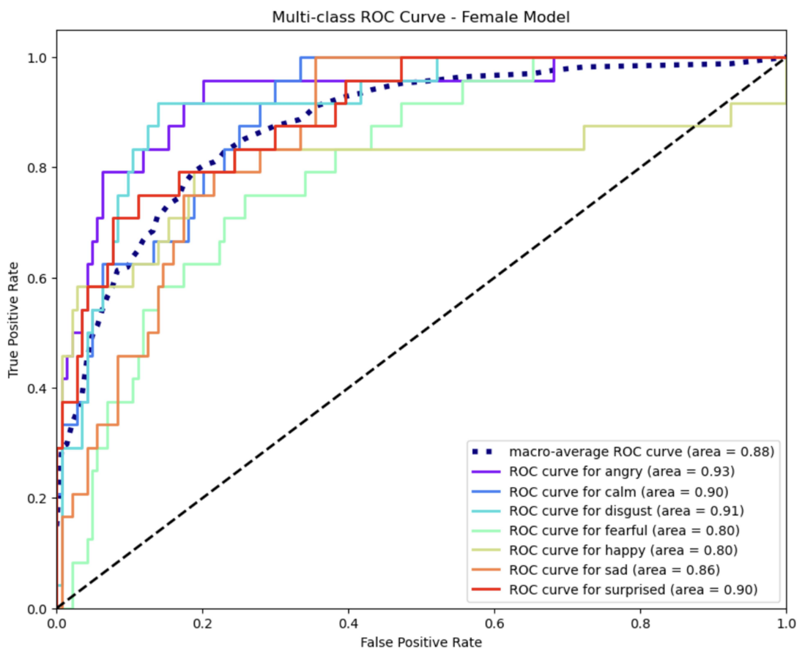
Multi-layer Perceptron Classifier
Female dataset results

Slide 6
What does it mean?
This method does not have the best accuracy.
ROC curve shows we’re headed in the right direction.
More voice emotion data is necessary.
Not a lot of available data currently.

Slide 7
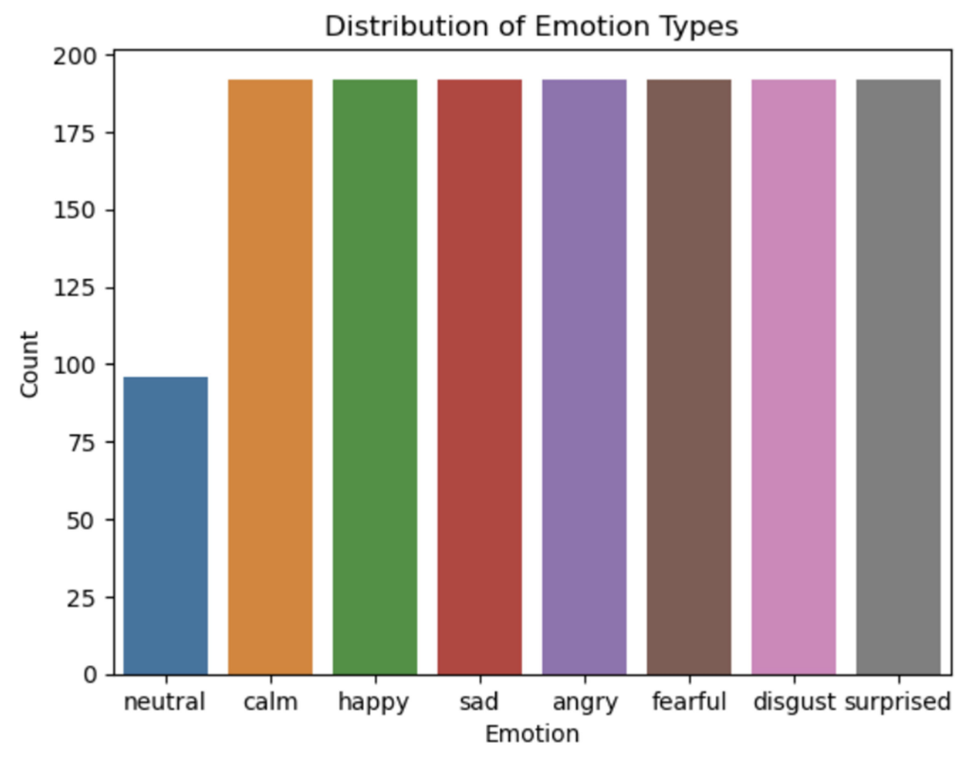
The Dataset
Ryerson Audio-Visual Database of
Emotional Speech and Song (RAVDESS).
24 actors
8 emotions
1440 total samples
Some Repeat Phrases / Emotions

Slide 8
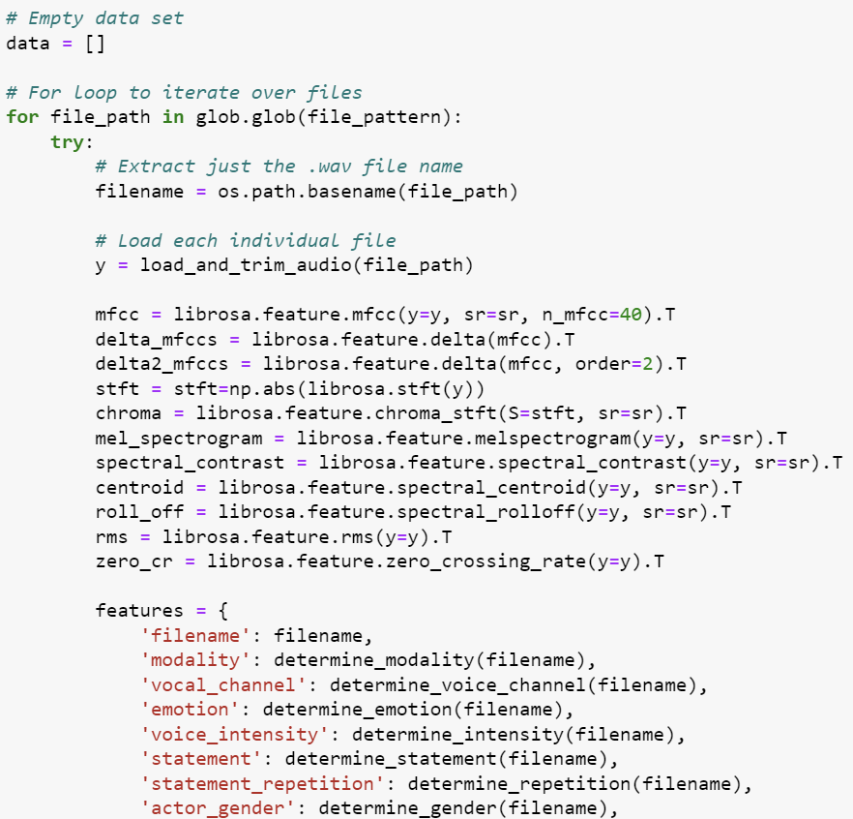
The Journey
To get to this point, I used Pandas
and Librosa to extract features.
Several tools were used from
Librosa’s library.
Several metrics for each tool were
applied as well.
This produced about 70 features
per audio sample.

Slide 9
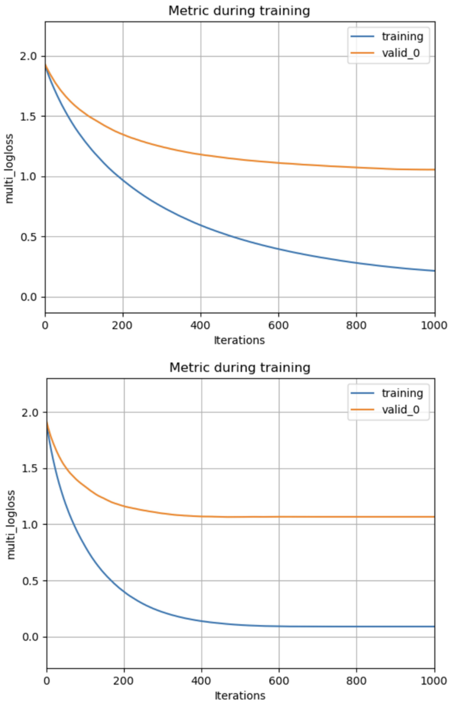
Tools and Metrics
Librosa feature extraction: mfcc, delta_mfcc, delta2_mfcc, stft, chroma, mel_spectrograph, special_ contrast, centroid, roll_off, rms, and zero_cr.
Metrics applied: mean, max, min, median, standard deviation, skew, and kurtosis

Slide 10
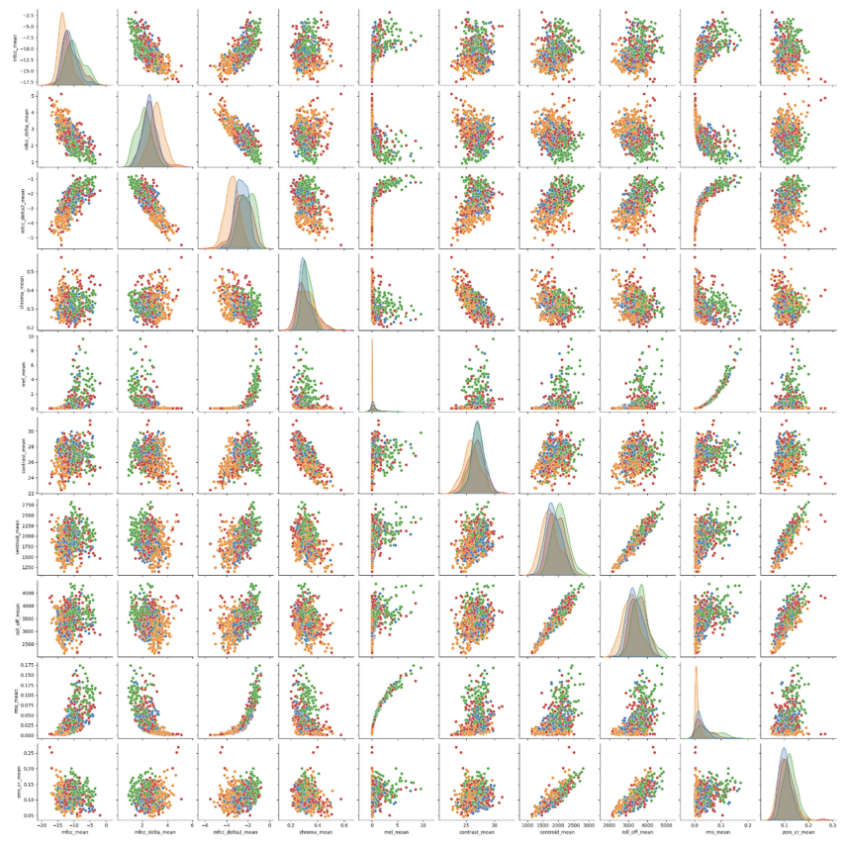
Visualizing
There was a lot of overlap with
each feature.
Needed more tools to
differentiate each emotion.
Used Random Forest Classifier
to provide feature importance.
Used Gradient Boosting as well.

Slide 11
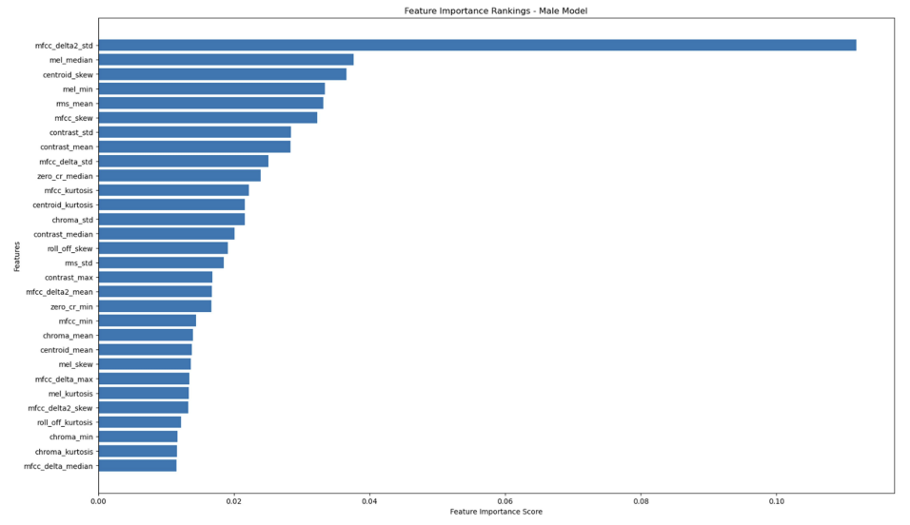
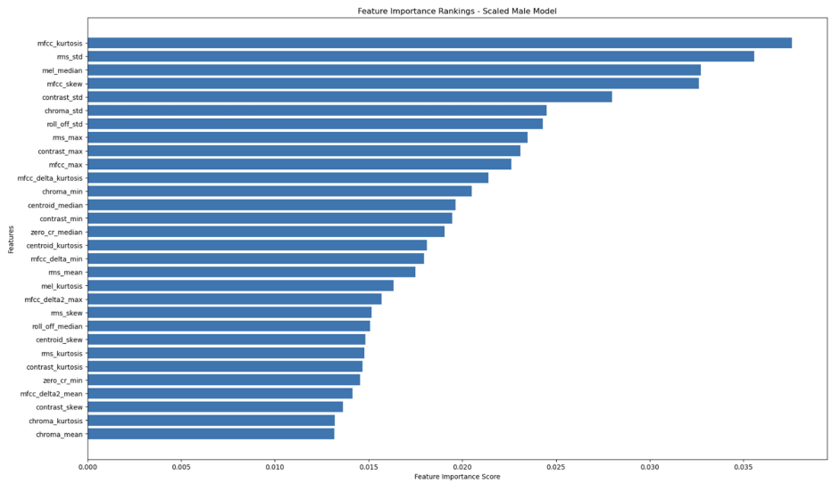
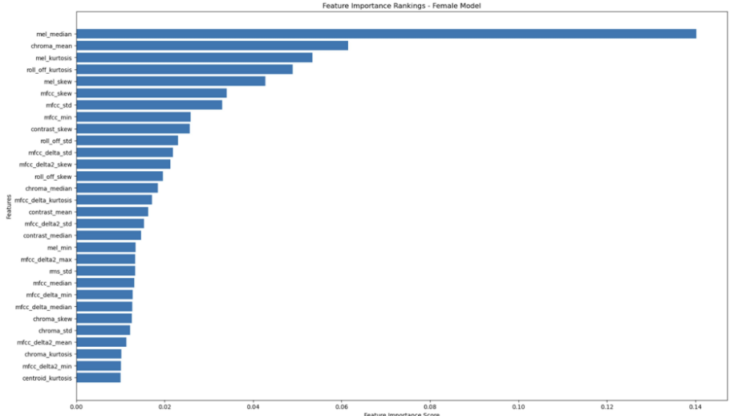
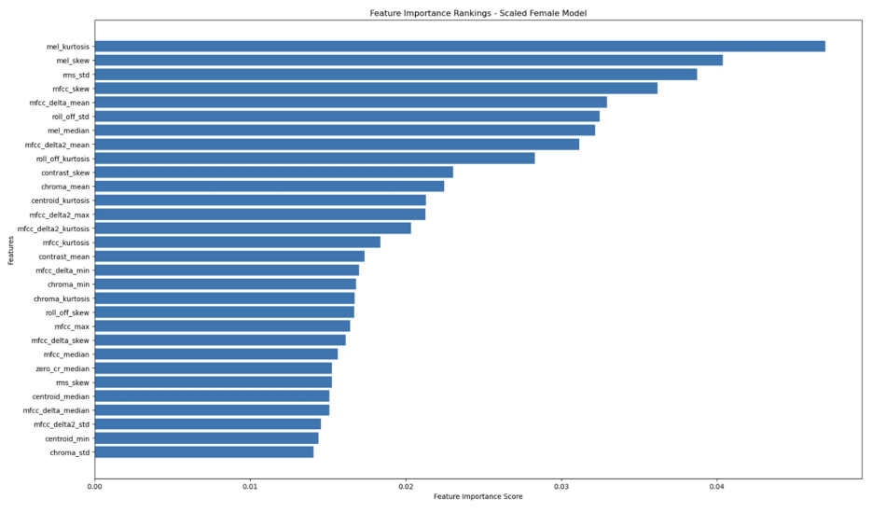
Feature Importance
Random Forest – Male Feature Importance
Gradient Boosting – Male Feature Importance
Random Forest – Male Feature Importance
Gradient Boosting – Male Feature Importance

Slide 12
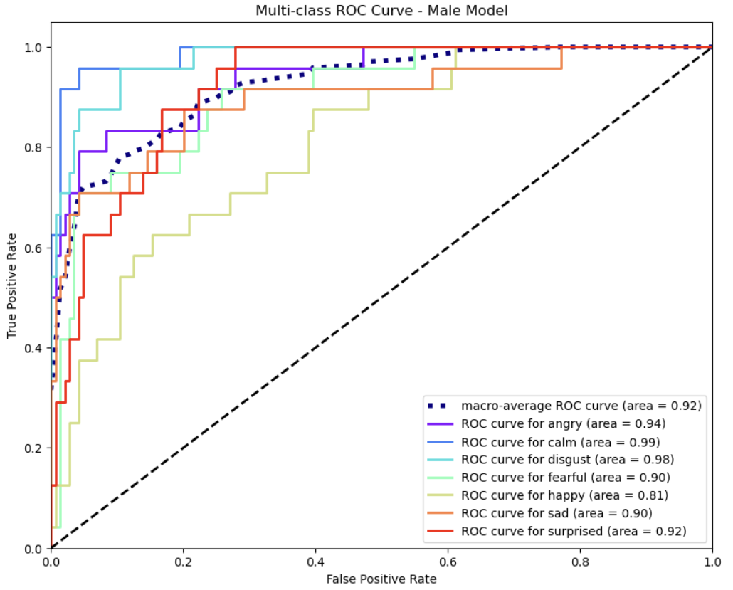
Top Features
Male dataset: mfcc_delta_median, rms_std, mfcc_delta2_max, contrast_median, and chroma_std.
Female dataset: mel_kurtosis, mfcc_skew, rms_std, mel_skew, and roll_off_kurtosis.

Slide 13
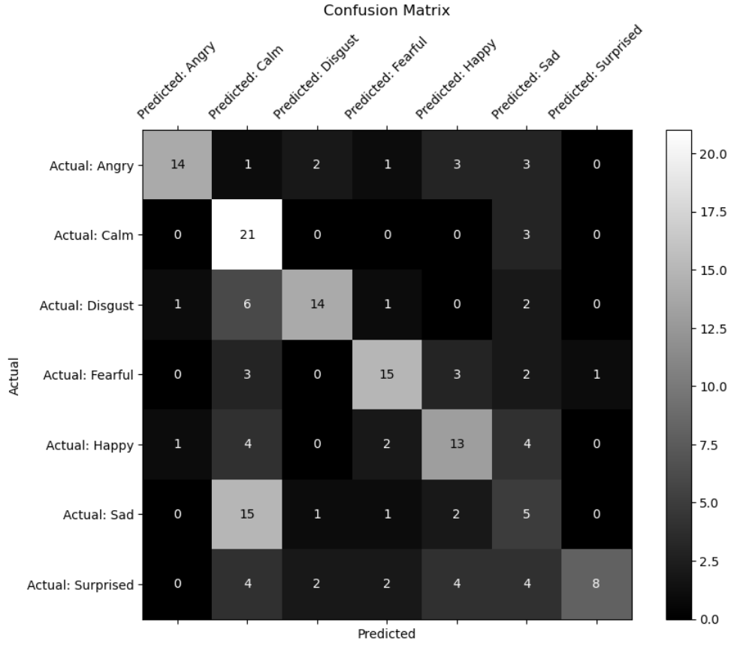
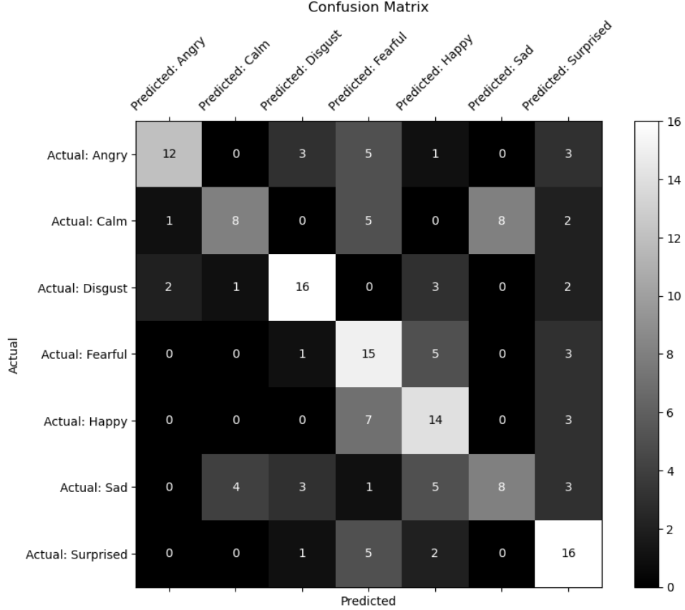
Results
Male dataset
Female dataset

Slide 14
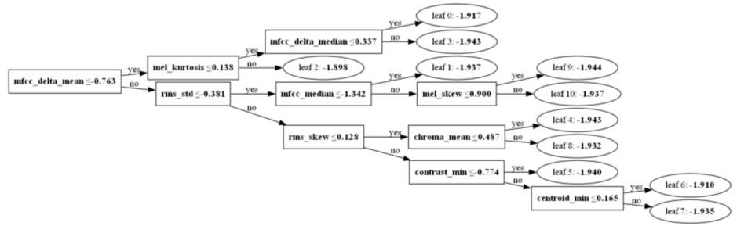
Conclussion
As you can see Sad and Calm were often confused for one another.
More professional audio data will be needed.
Using Librosa to turn an audio problem into a visual one could potentially yield better results.

Slide 15
Thank you!
Academic citation
Livingstone SR, Russo FA (2018) - The Ryerson Audio-Visual Database of Emotional Speech and Song (RAVDESS): A dynamic,
multimodal set of facial and vocal expressions in North American English. PLoS ONE 13(5): e0196391. https://doi.org/10.1371/journal.pone.0196391.
All other attributions
"The Ryerson Audio-Visual Database of Emotional Speech and Song (RAVDESS)" by Livingstone & Russo is licensed under CC BY-NA-SC 4.0.

